Slide 1
PDE3413 Project demonstration
Hamza Bari M00668318

Slide 2
What this project is about?
A Robotic System Finding of different temperatures in an area/room and compare them, to make a decision.
On decision made navigate the robot out of that area/room.
Make sure the robot doesn’t hit any obstacles/objects while navigating in or out of the room/area.
Using I/O device to alert which type of decision the robot has made.
Use Output mechanism to alert when the navigation has been completed.

Slide 3
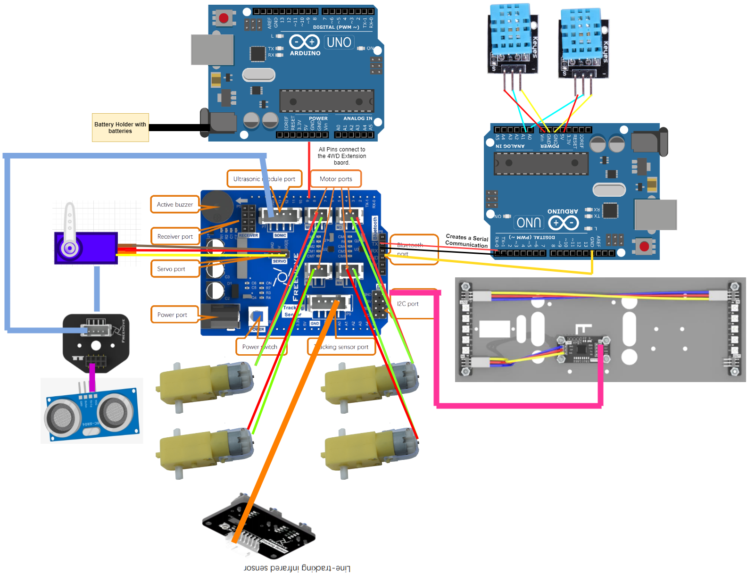

Slide 4
Sensors Used in the Project & Why
2x Arduino Uno – 2 Arduino due to lack of space in one to add more sensors
4x gear motors – robot navigation
4x wheels – attached to gear motors to the wheels to start moving
2x DHT11 Temperature & Humidity sensor – measure 2 temperature values and compare and contrast to make a decision
1x 4WD Arduino Uno Extension board – connecting to ports corresponding to robot Arduino pins
1x Servo motor – rotating the ultrasonic module connecter
1x Ultrasonic module connector – connecting the ultrasonic sensor to it
1x Ultrasonic sensor – to detect objects in front
1x WS2812B_LED_controller – to output LED lights based on the type of navigation
2x WS2812B_LED – output the colour onto the LED which is set in the algorithm
Double-sided and Single-Sided Jump wire pins for sensor and actuators connections
2x 18650 3.7V batteries – giving power to the Arduino
Batter holder with power jack connection to the Arduino Uno.

Slide 5
Issues with things not working after implementation.
Obstacle avoidance using the ultrasonic sensor doesn’t work as, the robot keeps of hitting the objects. The functionality has been implemented and it is there as the ultrasonic sensor rotates but, it still hits the objects as, a result there must be errors in the algorithm. The solution will be discussed in the later sections.

Slide 6
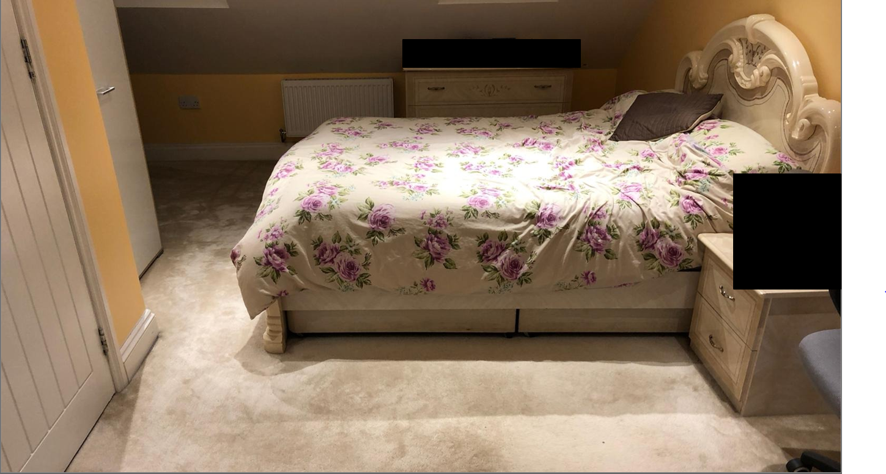
Area Two
Area One

Slide 7
Physical Demonstration of the System Working
Now, I’ll show you the videos of the physical demonstration.

Slide 8
Further Developments to the current system
As, there is an issue with the obstacle avoidance algorithm therefore, we needs to break down the algorithm. Test each line in the algorithm where it’s causing this issue. Therefore, when the errors are found then, change them and test them so they work fine and obstacle avoidance works for the next updated version.
Add 3 extra ultrasonic sensor, around the robot such as the left, right, and the back side for avoiding obstacles from those angles as well.
Use Bluetooth module communication instead of serial communication between 2 Arduinos, and printing temperature values to the PC serial monitor.

Slide 9
The physical demonstration video & these slides are in the project folder if they want to be seen separately later on.
Thank You Hamza Bari.

